Slide 1


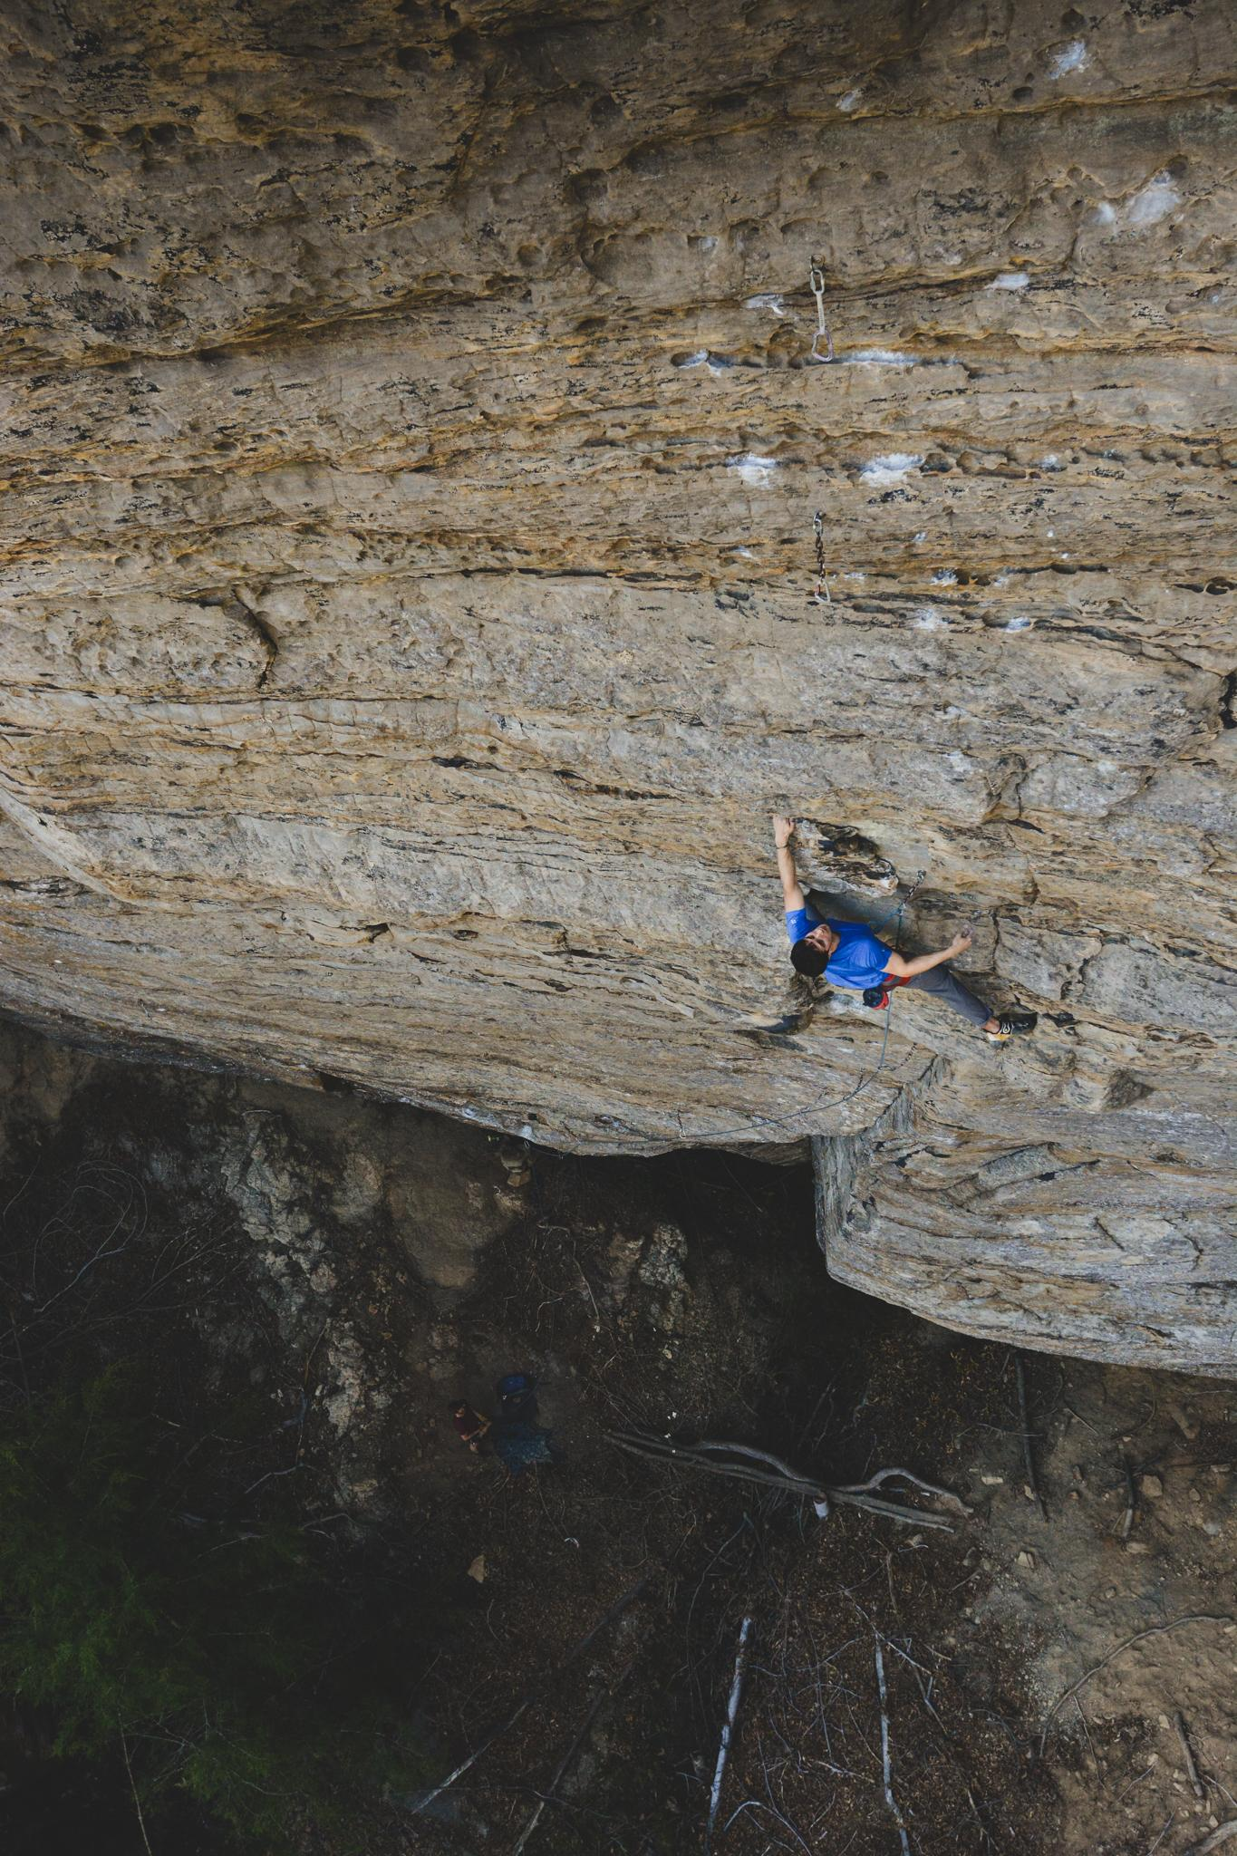
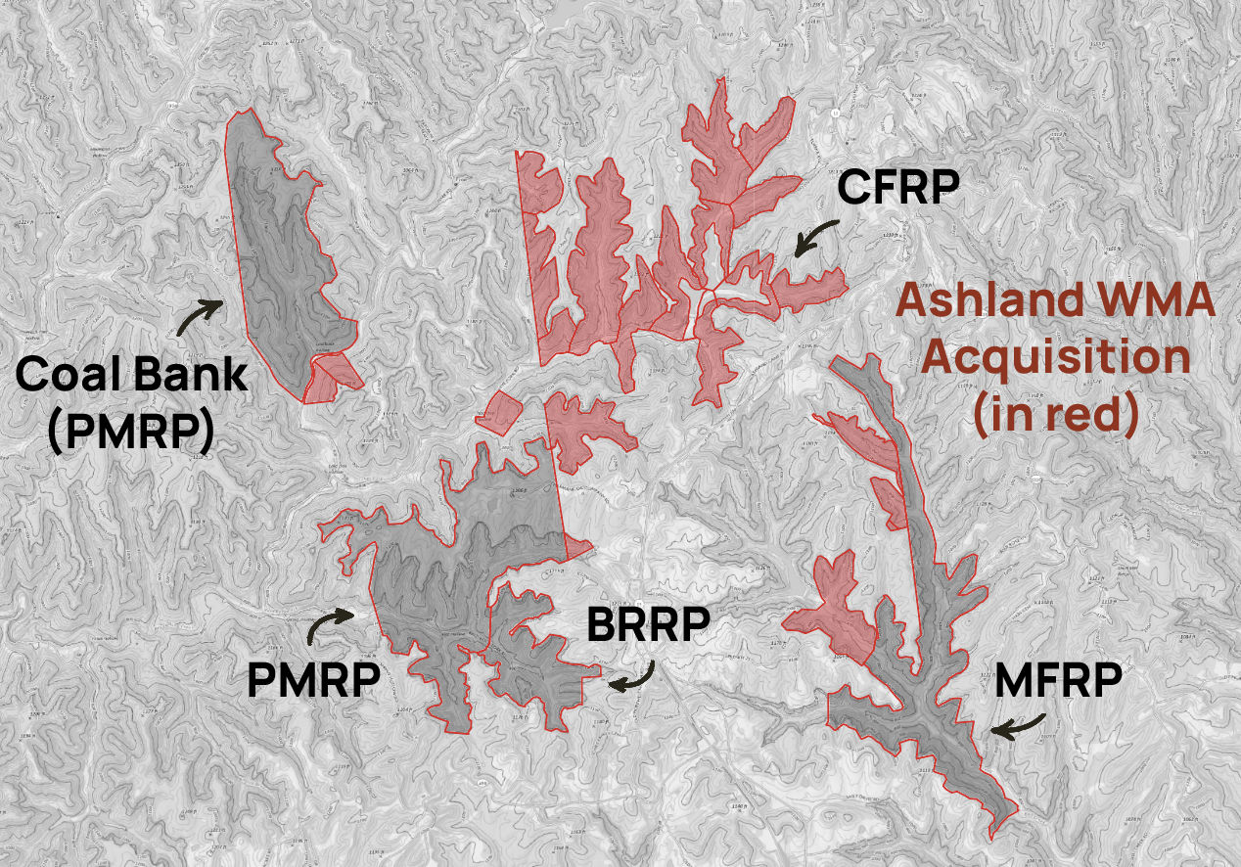
Ashland Developers Information Call
April 17, 2025

Slide 2
Agenda
Introductions
Developer Information & Recommendations
Property Information
Access Information
Route Development & Reporting
Developer Coordination
Hardware
Questions and Answers

Slide 3
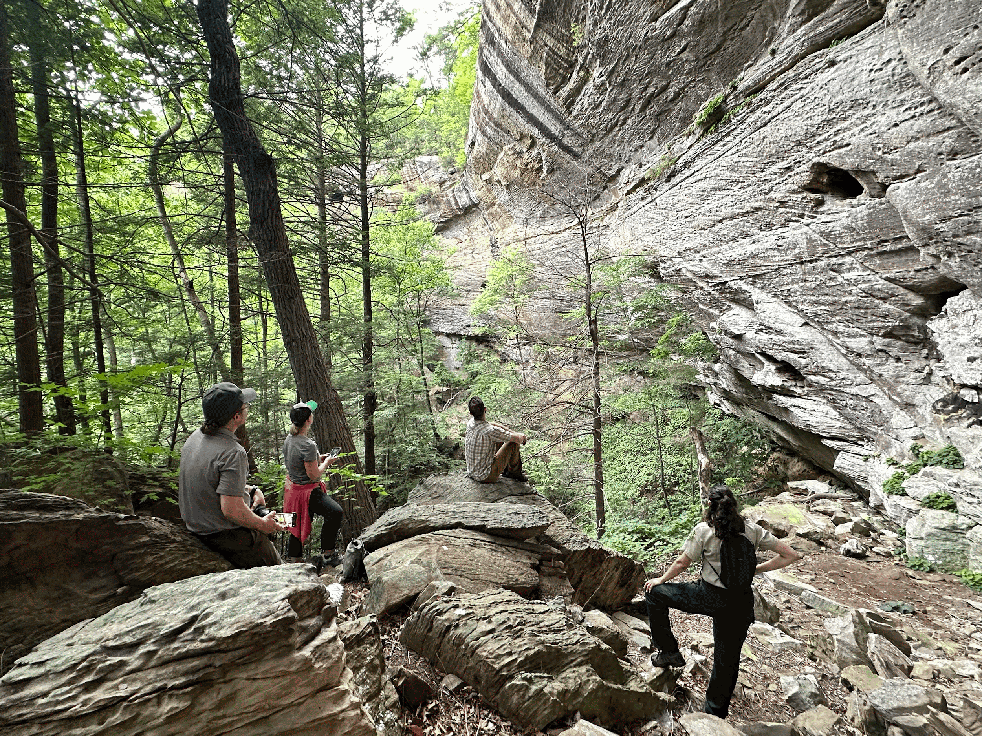
Introductions
Billy Simek
  Executive Director
Jereme Ransick
  Access & Acquisitions
Curtis Gale-Dyer
  Land Manager

Slide 4
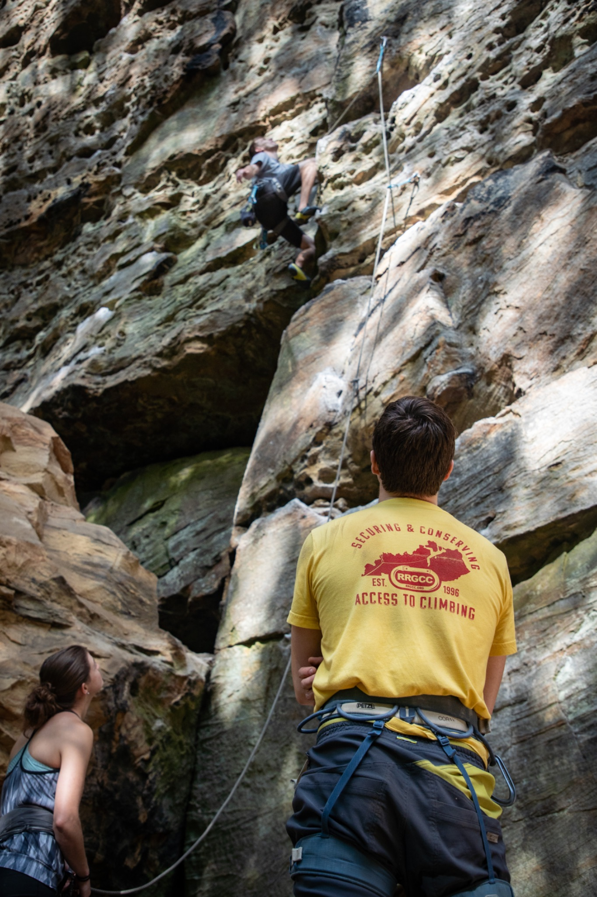
Developer Information & Recommendations
  Review & Complete Forms
    RRGCC Climbing Waiver
      General liability waiver
      Required for all RRGCC properties
    RRGCC Developer MOU
      Route development guidelines
      Hardware recommendations
      Bolting recommendations

Slide 5
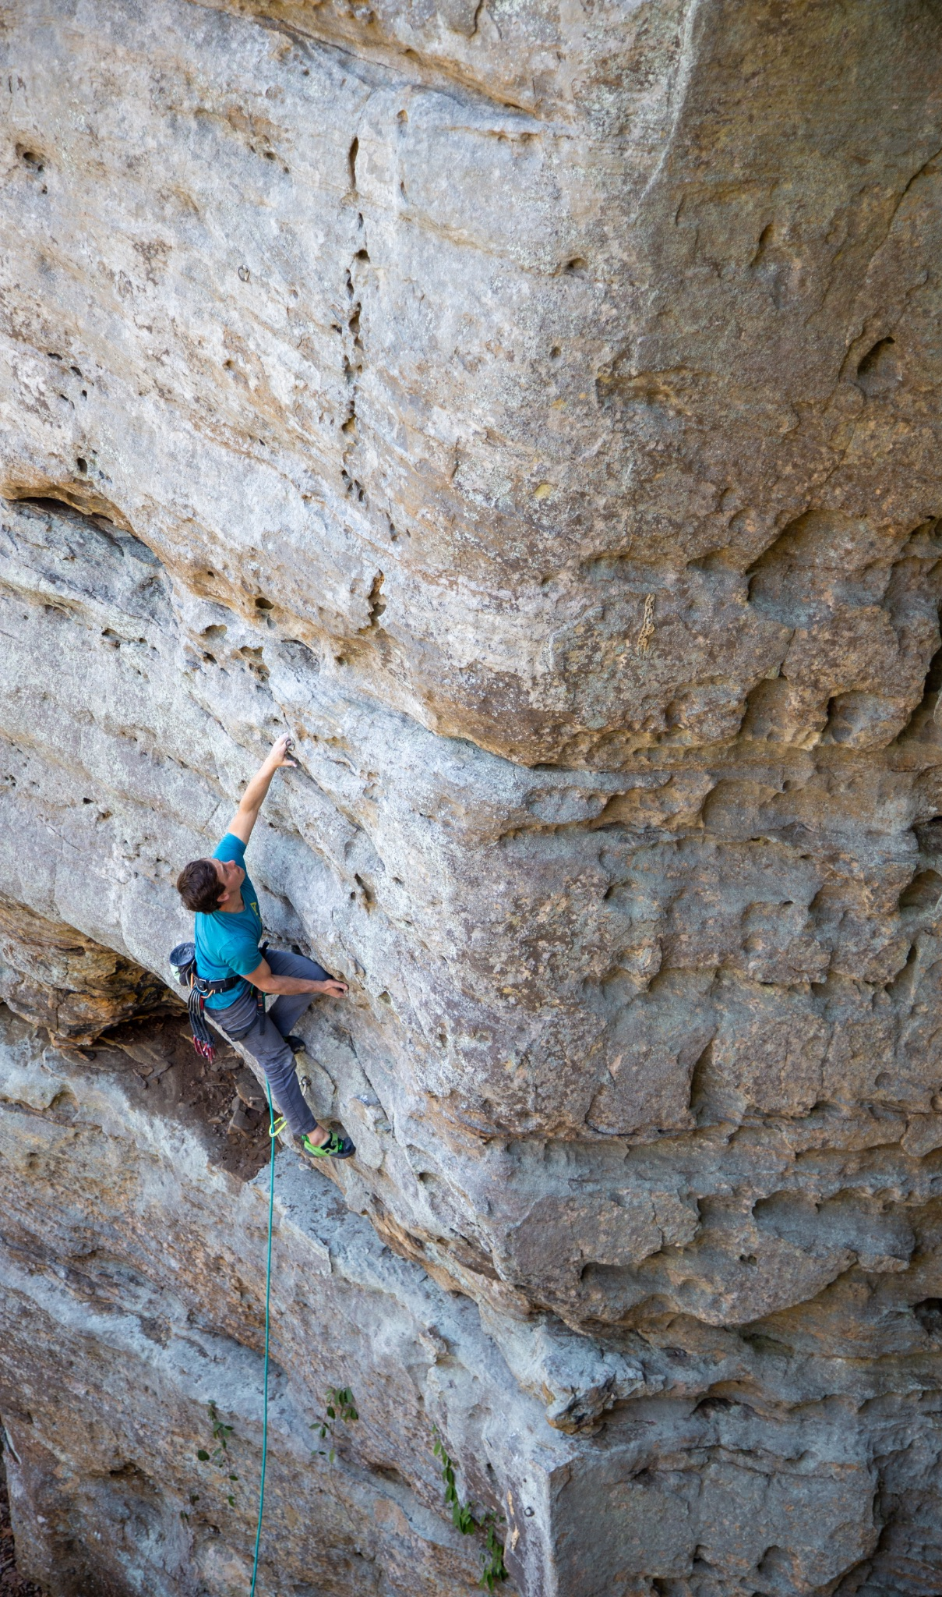
Property Information
Cave Fork Recreational Preserve (582 acres)
Miller Fork (+ 109 acres) & PMRP (+ 27 acres)
Maps
  Ashland PNG map
  Ashland online maps – RRGCC & Google
  Ashland offline maps – Avenza
Cliffs & Existing Development
  Over 14 miles of cliffline total
  Monster Wall, Outer Space, Hell’s Kitchen, Cornflake, The Venue, Pandemic Wall

Slide 6
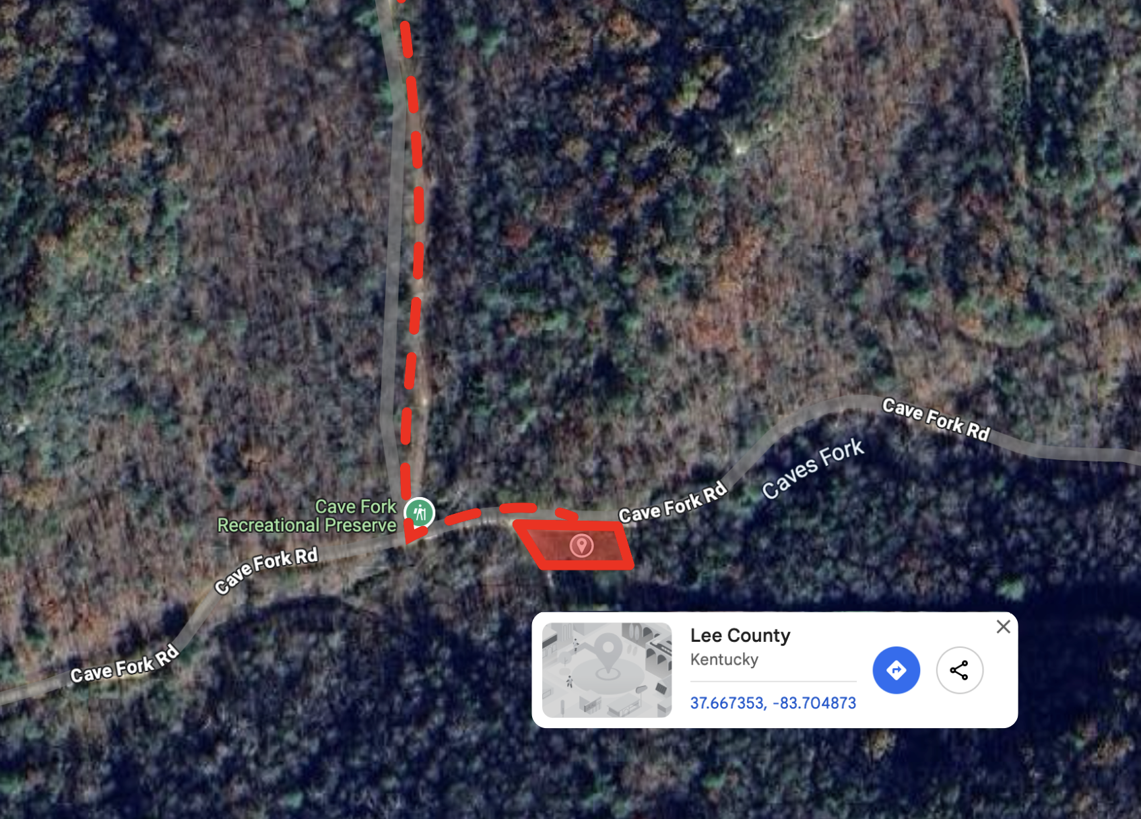
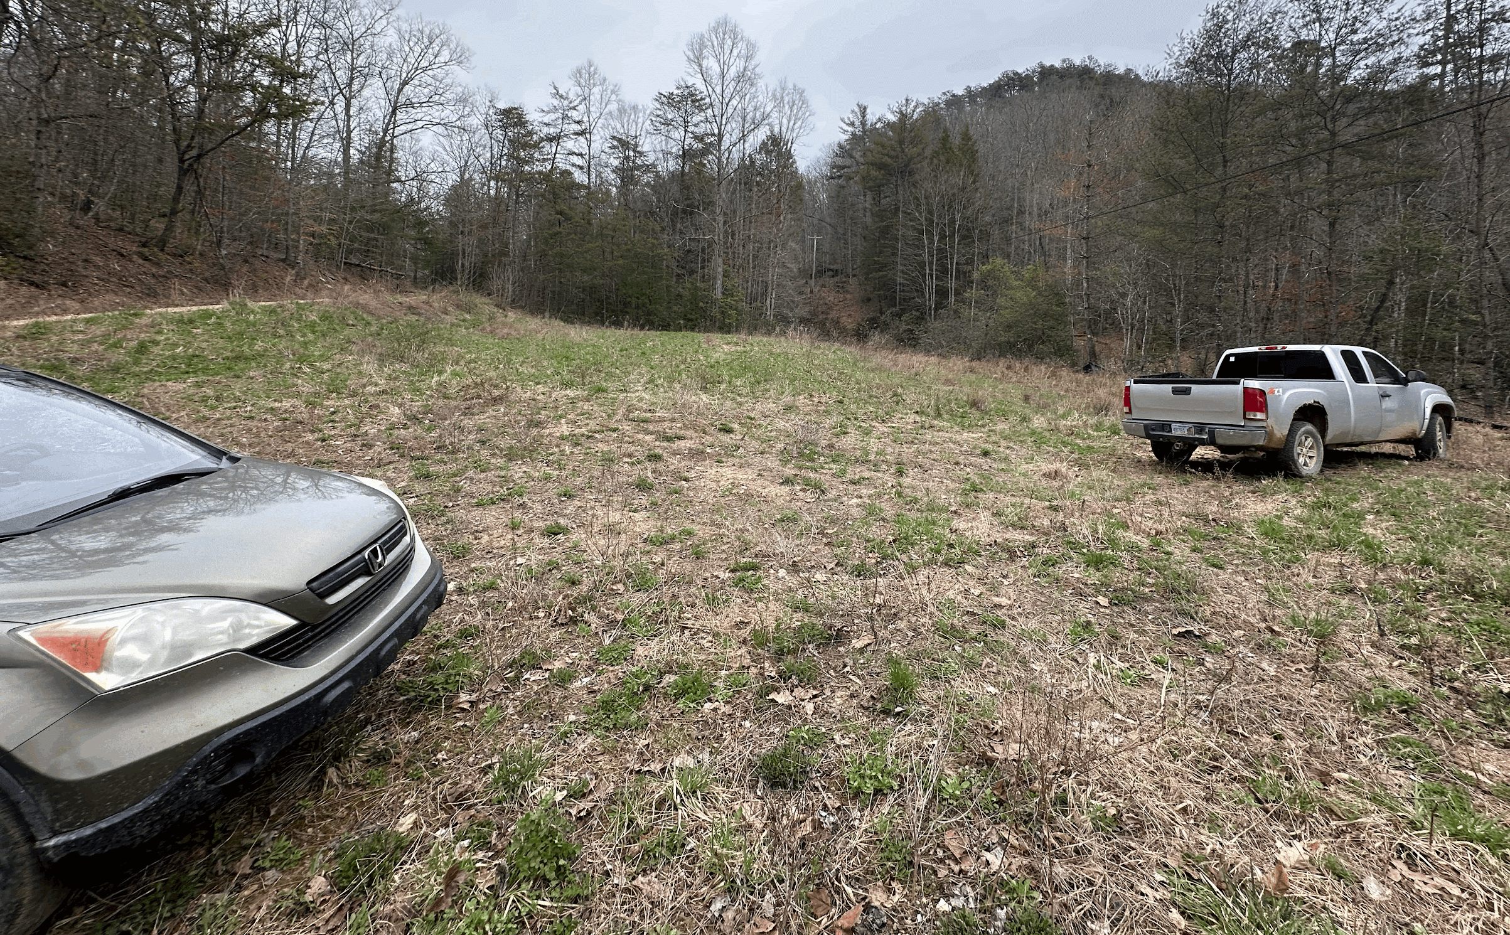
Access Information
Stay on established roads, do not drive around closed gates
Foot access only on Perdue’s road around Cave Fork Lake
Cliff-top access allowed through any ITRE / HRRG property
Do not block oil equipment
Temporary parking areas
  Ash Cave Hollow (37.667340, -83.705073)
  Cave Fork Lake (37.667237, -83.699362)
  North Fixer Access (37.679483, -83.708147)

Slide 7
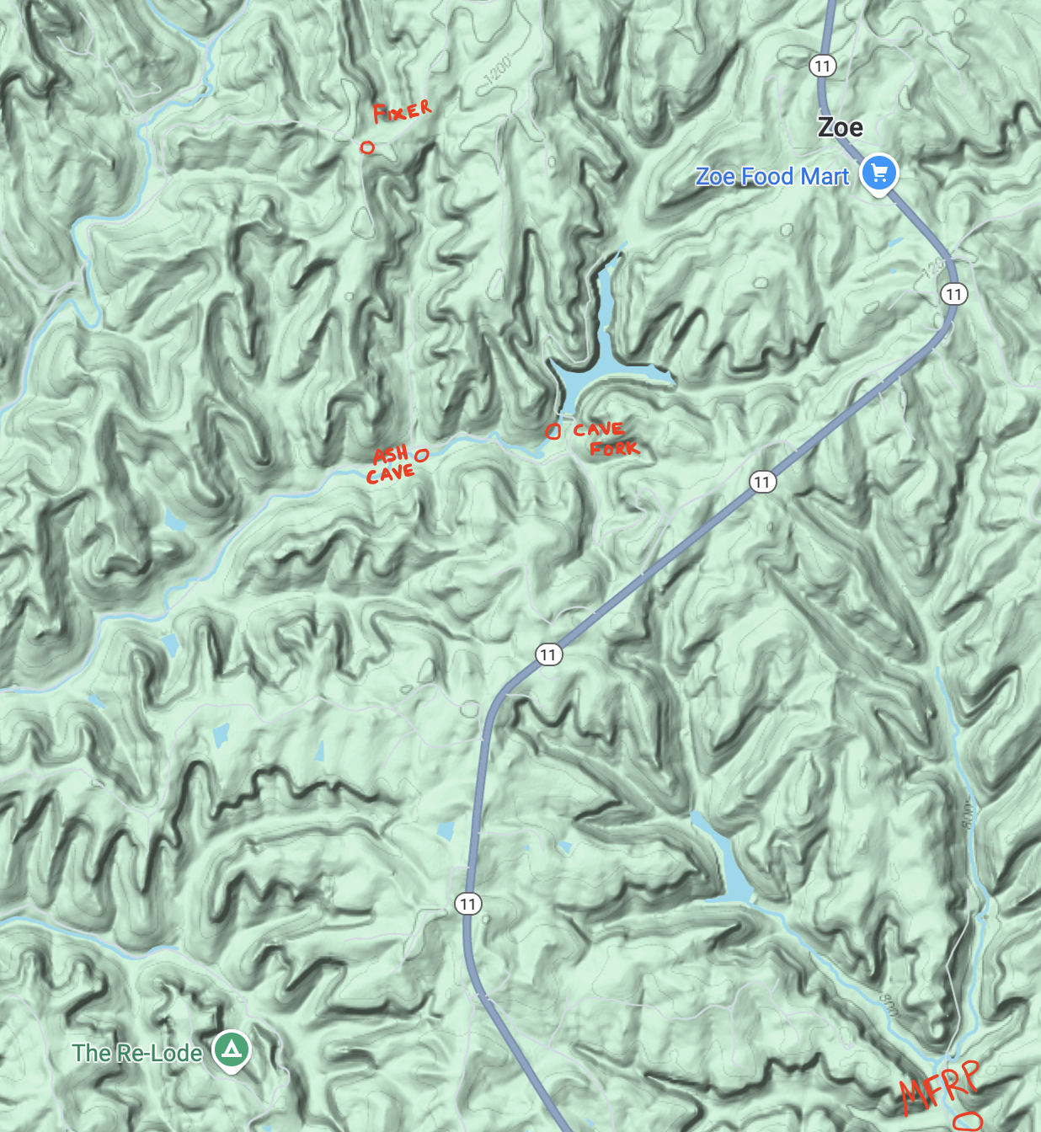
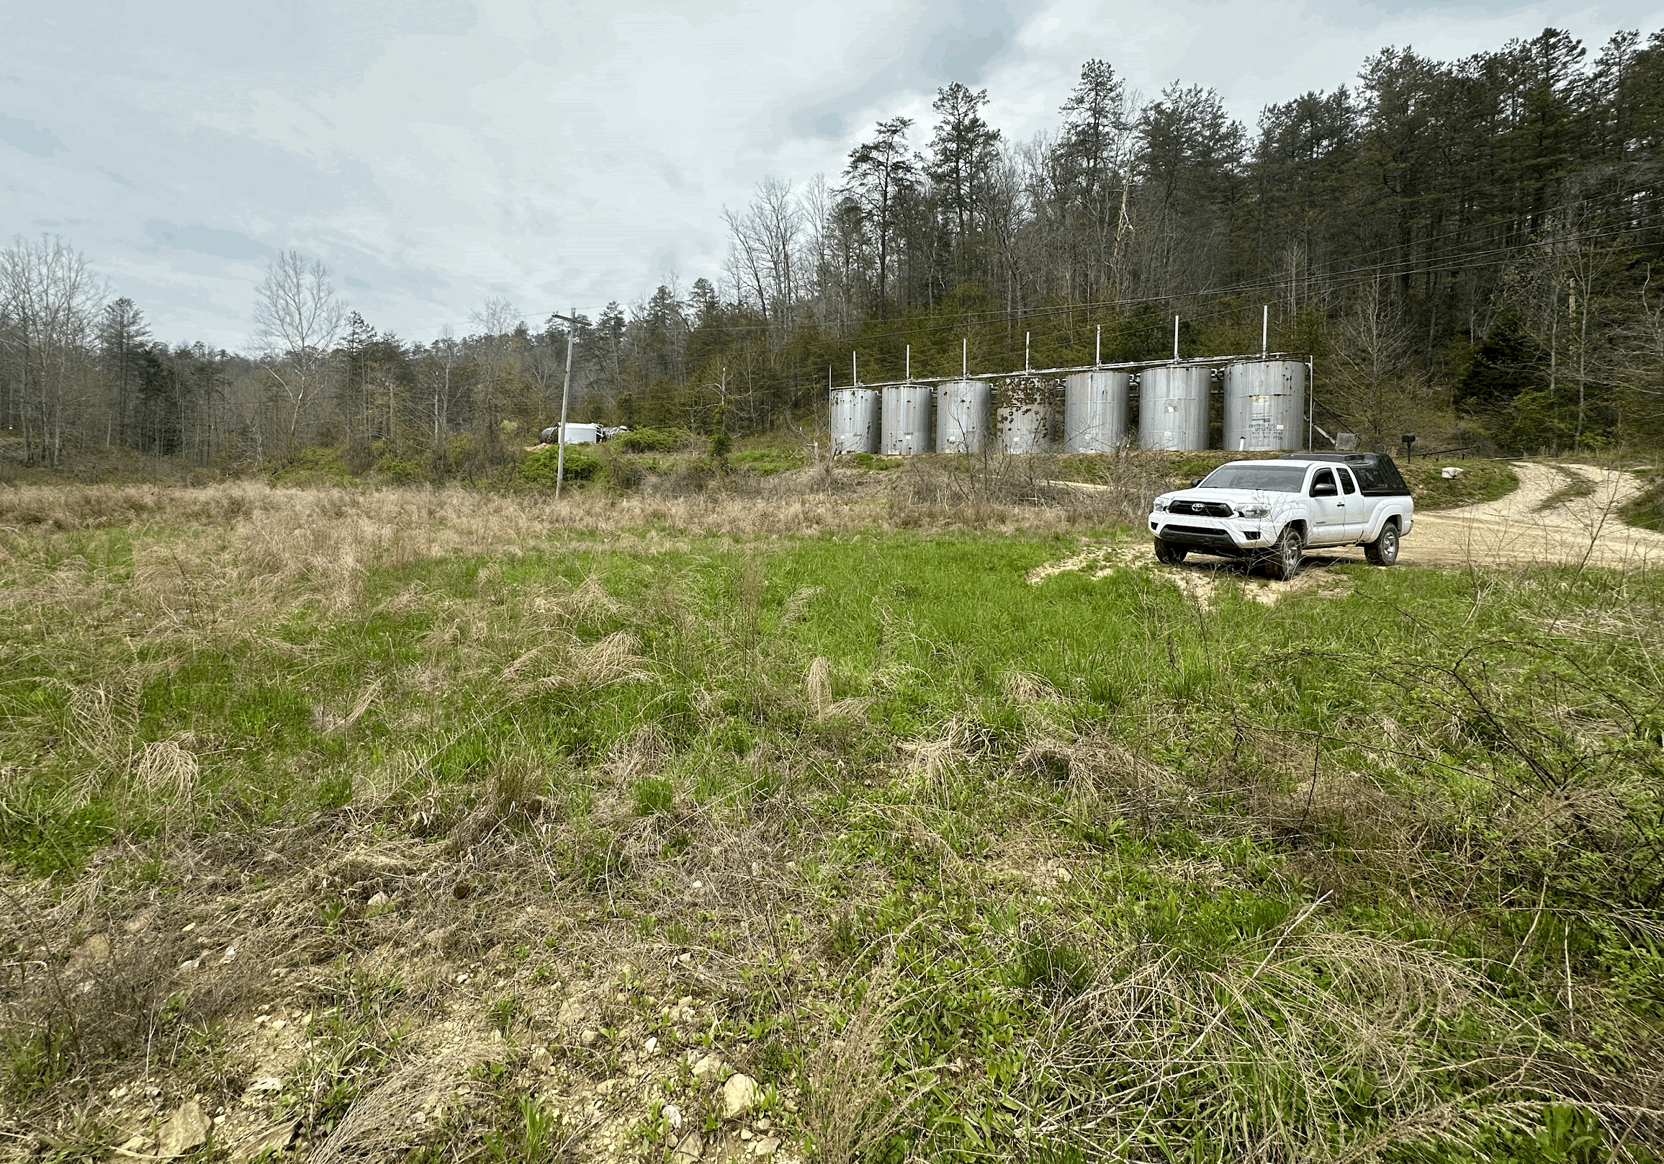
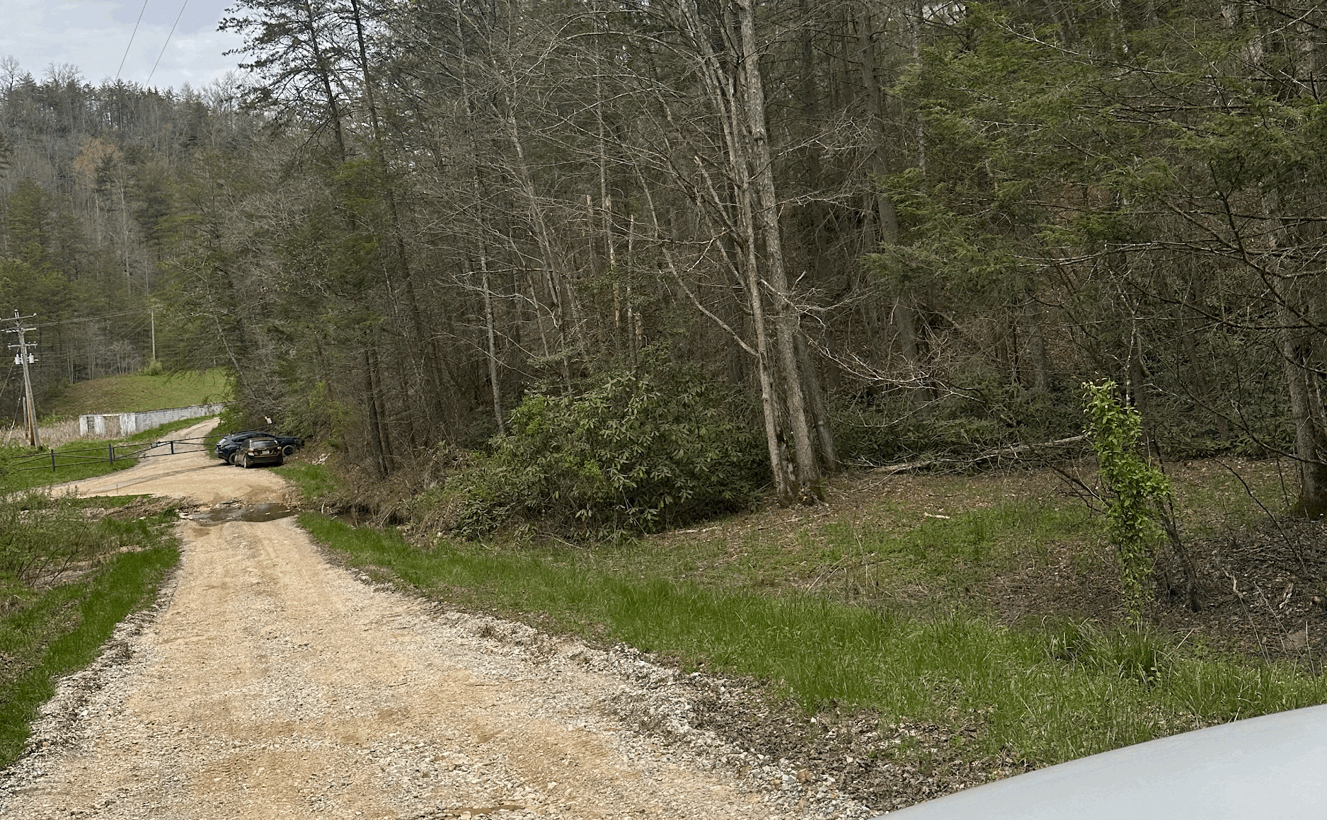
Ashland Parking

Slide 8
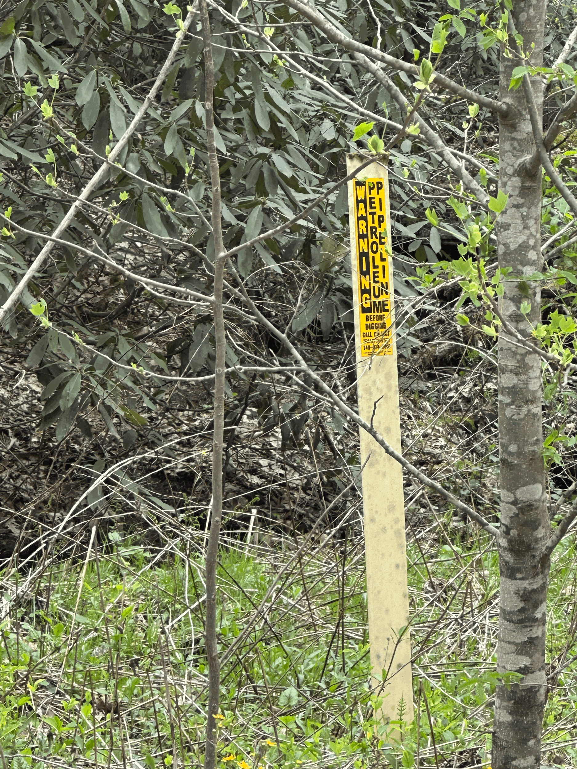
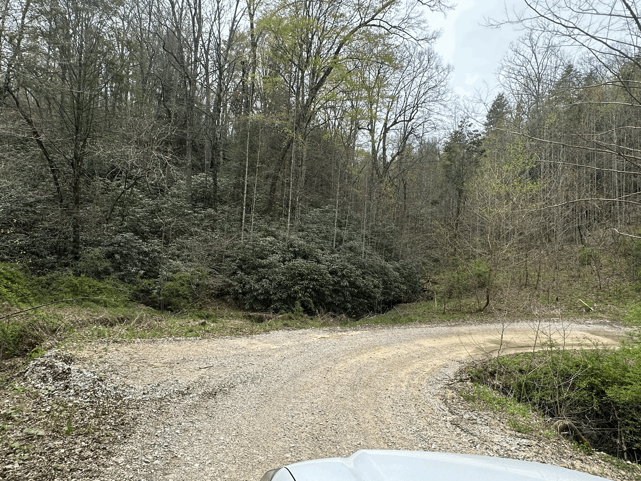
Ashland Parking
DO NOT park near oil equipment or buried pipelines
DO NOT park on the side of Cave Fork Road, use pullouts

Slide 9
Route Development & Reporting
Review & complete RRGCC waiver & developer MOU
Verify routes are within the property boundaries
  Using RRGCC provided maps and tools
  Uncertain? contact access@rrgcc.org
Bolt choss
Complete the RRGCC New Route Submission Form (not public-facing)
Red tag until sent and/or open
Do not publish any new route information
  Don’t post on Mountainproject, redriverclimbing, 8a, Instagram, etc. until crags are open
  Wait until RRGCC notifies of completed infrastructure and ensuing opening of crag to the public

Slide 10
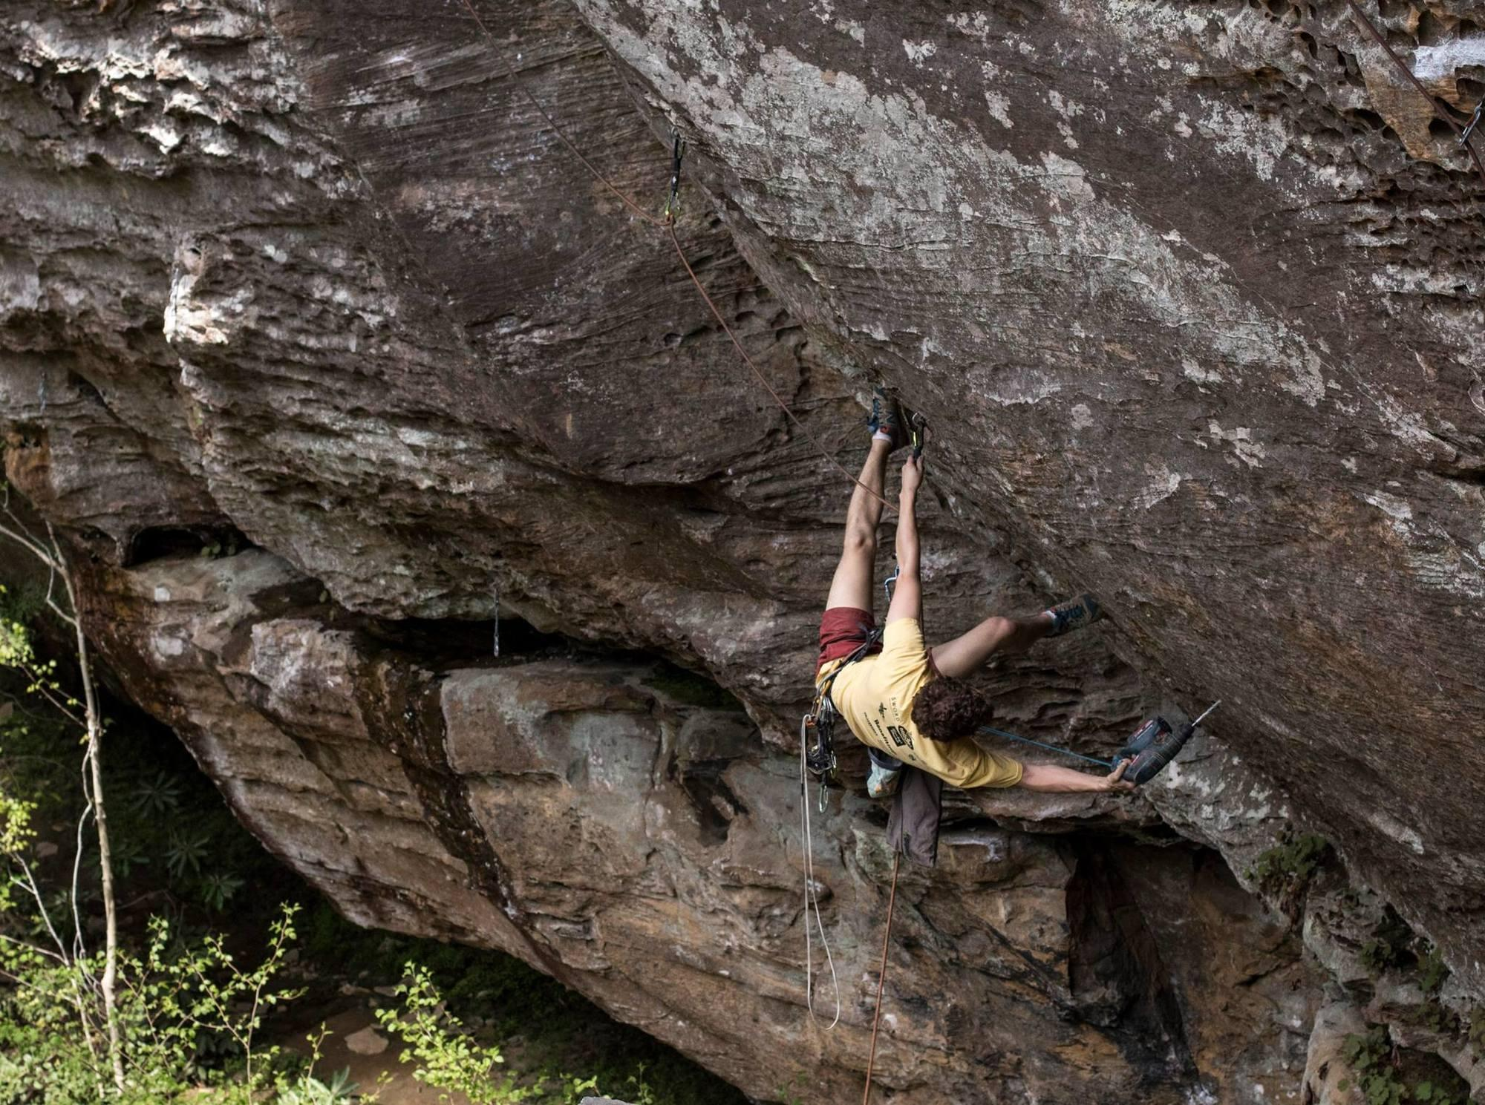
Route Development Considerations
Tread lightly through the forest & cliffline ecosystems
DO NOT cut down trees or remove substantial vegetation without Land Manager approval
Does that route need to be bolted?
Bouldering
  Use the same process, guidelines, and route submission form

Slide 11
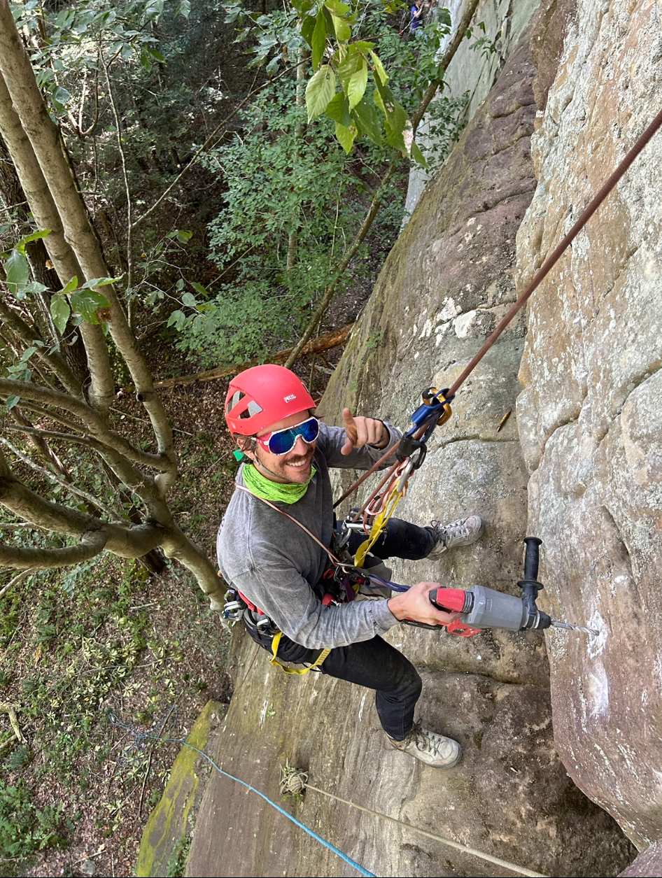
Developer Coordination
Only Temporary Developer Trails Allowed
  Minimize size and impact
  DO NOT cut in trails or remove vegetation
Respect Other Developers
  Fixed Ropes
  Red tags
  Don’t be territorial
Self-Organization
  RRGCC is not controlling development or developers
  Encourage coordination as a community as you see fit
  Experienced developers consider mentoring others
Notes:
Ashland crags in development – Dev-organized (Haskell) to provide ease of communication

Slide 12

Hardware
FGI providing subsidized, high-quality hardware (@rrgfixedgearinitiative)
  Stainless steel glue-in bolts & epoxy
  Stainless steel 5-piece bolts
  Anchor hardware
Review hardware recommendations in RRGCC Developer MOU
Plated bolts not recommended
Do not use wedge expansion bolts

Slide 13
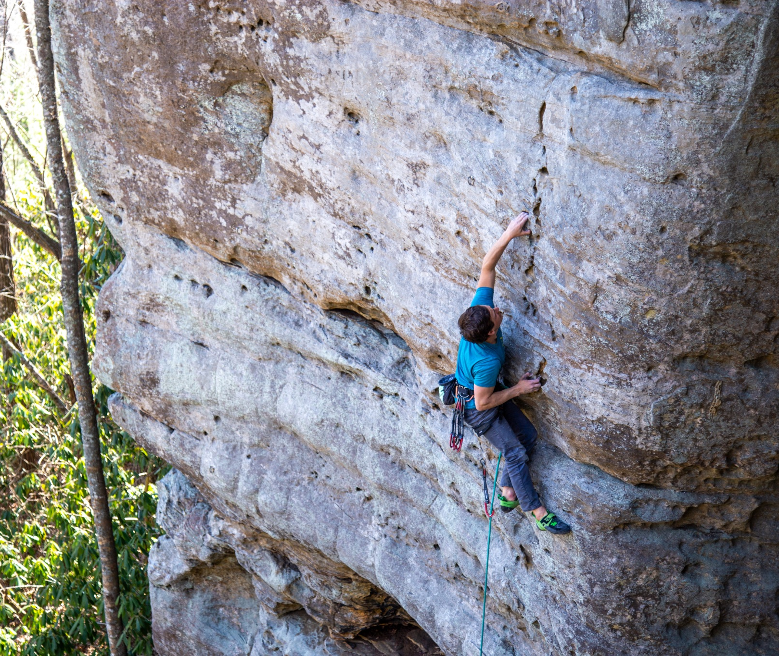
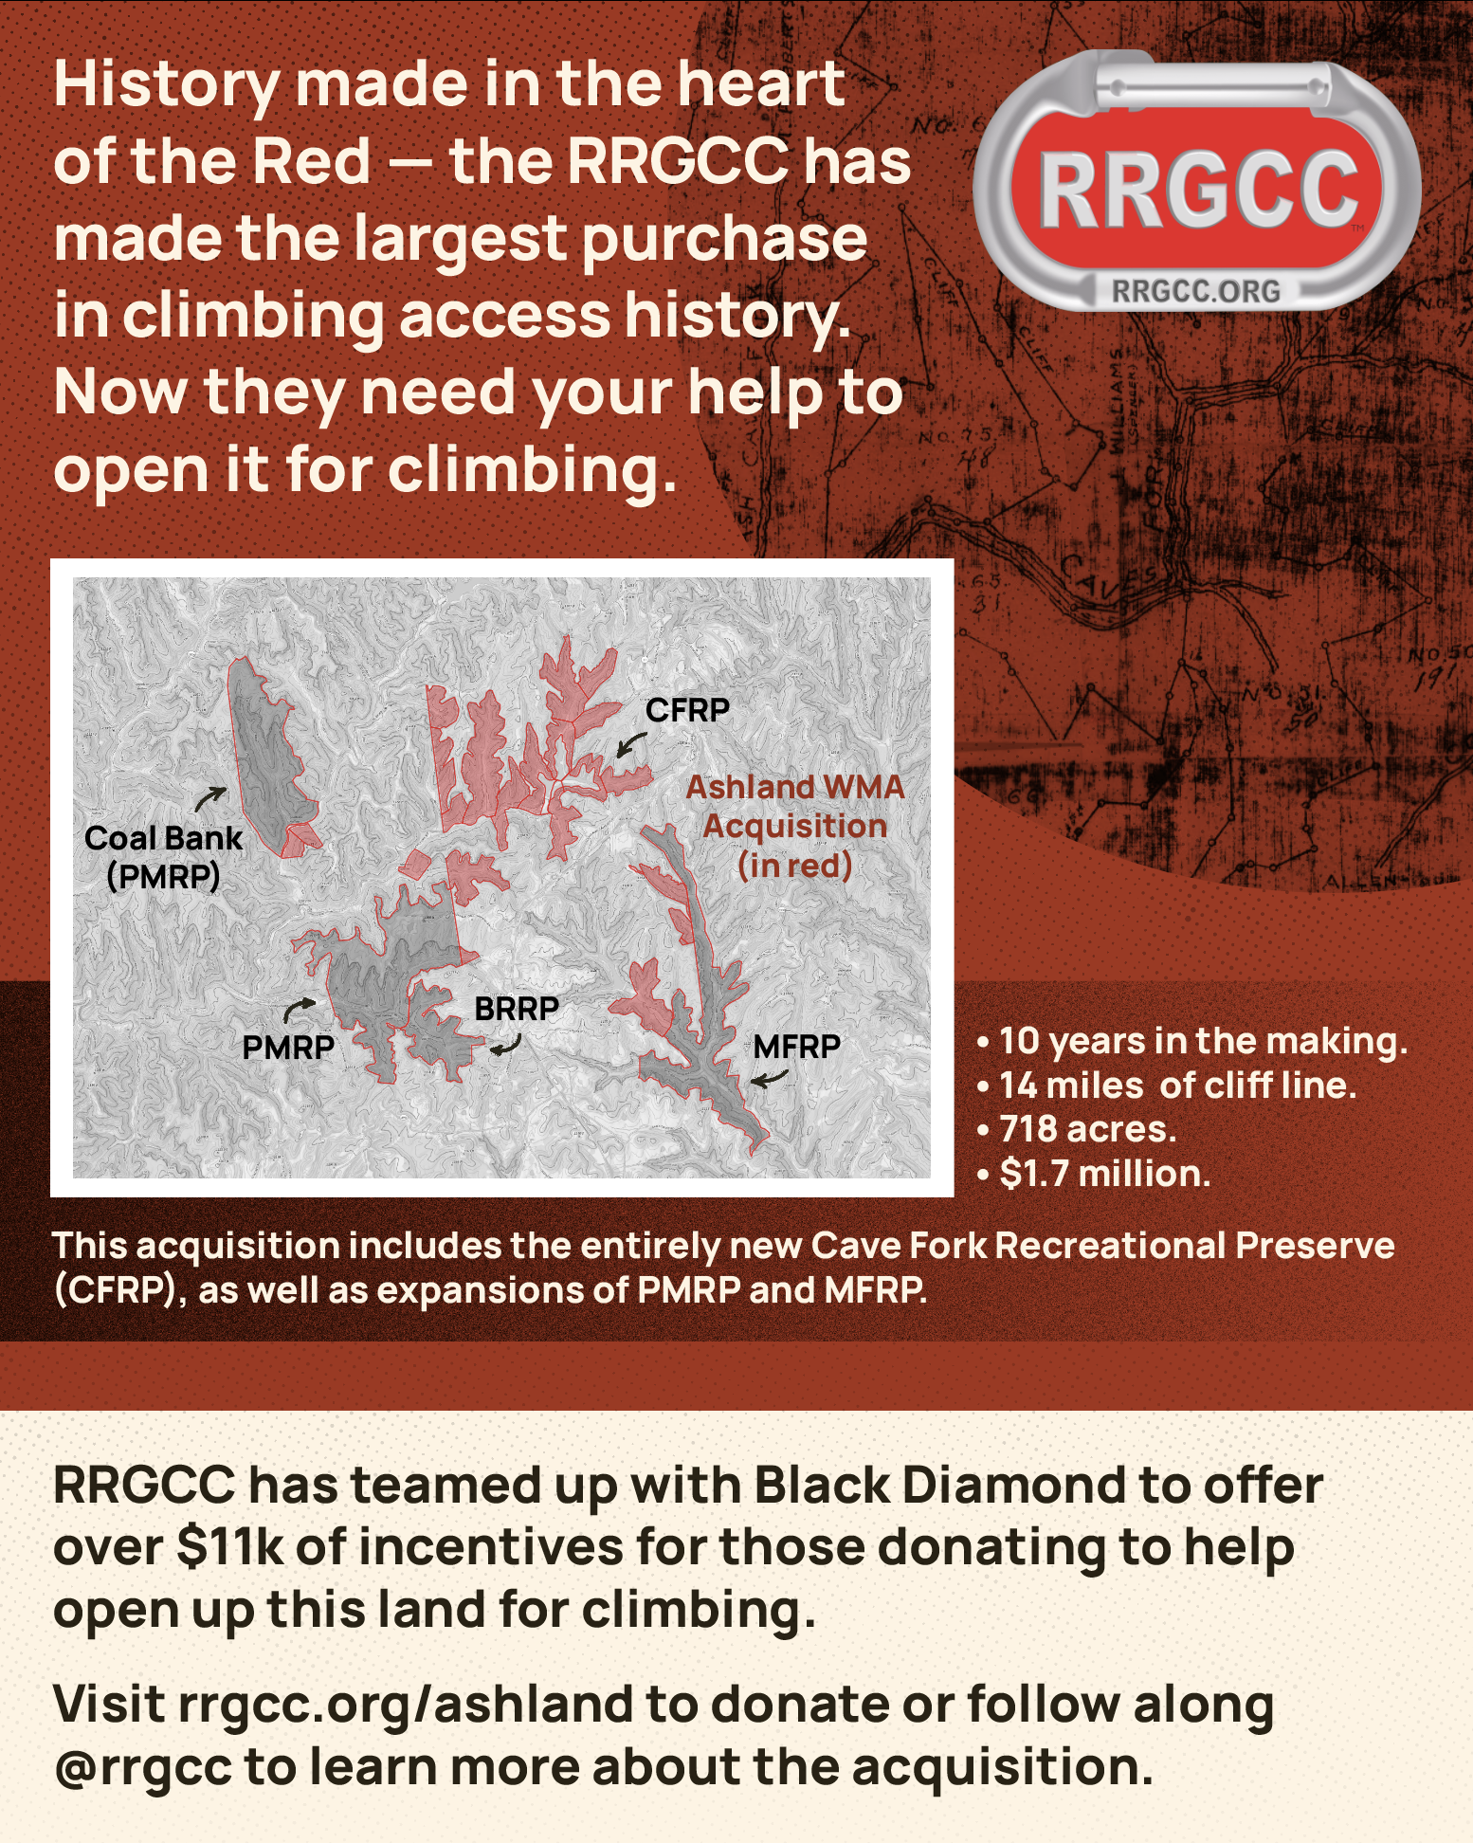
Questions & Answers
CLAIMED

